Slide 1

Computer Generated Fiction

Slide 2
Existing solutions
Dividing the problem
My model of fiction

Slide 3
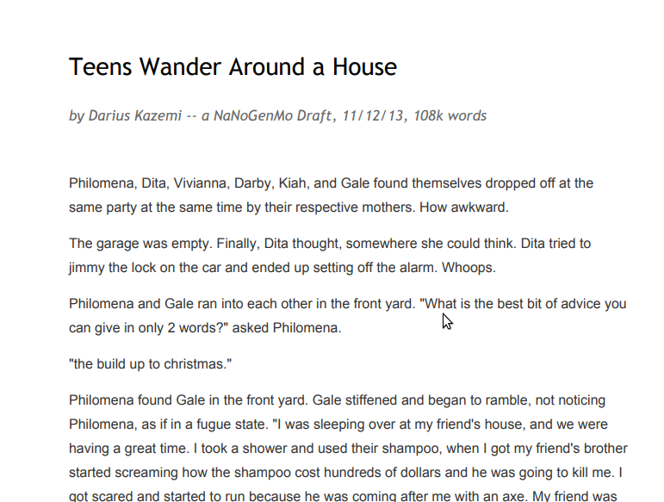

Slide 4
garage: {
name: 'garage',
objects: ['BMW', 'riding lawnmower'],
actions: [
'considered getting on that lawnmower and riding it out of this place.',
'peered in the car door for some kind of clue as to whose house this was.',
'tried to jimmy the lock on the car and ended up setting off the alarm. Whoops.'
],
exits: ['patio', 'frontyard', 'greathall']
},
frontyard: {
name: 'front yard',
objects: ['lawn', 'tree'],
actions: [
'started to climb the tree, then thought better of it.',
'ran her fingers through the well-manicured grass, dreaming of better days.'
],
exits: ['living', 'foyer', 'garage']
},
Notes:
700 lines of python

Slide 5
action: function() {
var actions = this.loc.actions;
if (actions) {
newRoom(this);
console.log(this.name + ' ' + actions.pick());
// If we've already done a solo action there's a good chance we'll do some thinking.
if (Math.random() < 0.25) this.think();
}
var thoughts = '';
thoughts += 'She thought about ' + other.name + '. ';
if (Math.random() < 0.4) thoughts += other.name + ' and that ' + other.items.pick() + ' of hers. ';
if (Math.random() < 0.4) thoughts += 'She ' + feelings.pick() + ' her so damn much. ';
if (Math.random() < 0.4) thoughts += 'She wanted that ' + other.items.pick().split(' ')[1] + '. Nothing else would do. ';
if (Math.random() < 0.4) thoughts += 'It was almost too much to deal with. ';
if (Math.random() < 0.4) thoughts += 'Why couldn\'t she be more like her? ';
if (Math.random() < 0.4) thoughts += 'Maybe if they could just be real with each other for once... ';
if (Math.random() < 0.4) thoughts += 'Nobody really knew how she felt. ';
if (Math.random() < 0.4) thoughts += 'Why did everyone want to be like her? ';
Notes:
General flow of a paragraph:
Someone enters a new room.
If someone else is in the room, they interact.
Else perform some action
Maybe think about something

Slide 6
function encounter(actor1, actor2) {
var encounters = [
actor1.name + ' encountered ' + actor2.name + ' in the ' + actor1.loc.name + '.',
actor1.name + ' and ' + actor2.name + ' ran into each other in the ' + actor1.loc.name + '.',
actor1.name + ' entered the ' + actor1.loc.name + '. ' + actor2.name + ' was there, as if waiting.',
'As ' + actor1.name + ' entered the ' + actor1.loc.name + ', she saw ' + actor2.name + ' making trouble.',
actor1.name + ' entered the ' + actor1.loc.name + ' to find ' + actor2.name + ' standing there.',
actor1.name + ' walked into the ' + actor1.loc.name + ' and saw ' + actor2.name + '. Great.',
];
}
function stare(actor1, actor2, dfd) {
console.log('\n');
encounter(actor1, actor2);
var stares = [
actor1.name + ' stared at ' + actor2.name + ' suspiciously.',
actor1.name + ' avoided ' + actor2.name + '.',
actor1.name + ' eyed ' + actor2.name + '\'s ' + actor2.items.pick() + ' with envy.',
'"Where did you get that ' + actor2.items.pick().split(' ')[1] + ', ' + actor2.name + '?" ' + actor2.name +' ignored her.',
actor1.name + ' played nervously with her ' + actor1.items.pick().split(' ')[1] + ' in a successful bid to avoid talking to ' + actor2.name + '.'
];
}

Slide 7
Writing Harry Potter with an LSTM neural network

Slide 8
LSTM - Long short-term memory
A type of recurrent neural network
Notes:
RNN – Processing considers previous inputs – it remembers what it’s already looked at.

Slide 9
There are clouds in the ___
Notes:
A recurrent neural network will easily guess sky, but the information it needs to guess French is too far back.

Slide 10
There are clouds in the ___
I lived in France for many years and I’m still good friends with people I met there, so it’s no surprise I speak fluent ____
Notes:
A recurrent neural network will easily guess sky, but the information it needs to guess French is too far back.

Slide 11
Long short-term memory networks choose information to keep or forget.
Notes:
Gives each piece of information a rating and discards those deemed less important.
Ratings can change with context – for example, the gender of the subject is very important to get pronouns correct until the subject changes, at which point that information is no longer relevant and can be forgotten.
LSTM networks are often used in speech recognition (siri, google translate).

Slide 12
And Fred and George have cooked out hard to Dumbledore’s put away the different column Thursday morning, and the first Weasleys, felt them in to a dance journey down the marble staircase. There was also a drip Dursleys and a door — Mr. Dursley pretended at the starry gold and dragged him over onto a deep breath while Harry knocked out of Uncle Vernon’s voice. “W-what?”
They shall go straight back into rats.
“I was back to… while I believe the headmaster is rubbish at that. And the right passages, was like an angry potion ‘round every point, you want not to listen about I was going to go, but I will be worrying about it and Fudge Granger, was an Animagus.”
They would have laughed hoarsely, out of Neville’s pocket and placed it through the next brick at him, as though he were bound to hear it on the Potions leg right in Gryffindor — when Lupin muttered quietly to Dumbledore.
“Pig snout,” they bowed back to the cabinet above the table. “That’s right,” said Harry offhandedly.
Notes:
It’s rather disappointing.

Slide 13
Two problems
1. The sentence problem
2. The context problem
Notes:
LSTM treated writing as one problem and provided one solution.
Here’s a new approach - split into two problems:
How to construct grammatically correct sentences (given some information)
How to string those sentences into a story.
13

Slide 14
Two problems
1. The sentence problem – 90% solved
2. The context problem
Notes:
Look at the sentence problem first – which I say is mostly solved because there are real systems that can reliably generate correct sentences.
14

Slide 15
Narrative Science - Quill
“Tuesday was a great day for W Roberts, as the junior pitcher threw a perfect game to carry Virginia to a 2-0 victory over George Washington at Davenport Field.
“Twenty-seven Colonials came to the plate and the Virginia pitcher vanquished them all, pitching a perfect game. He struck out 10 batters while recording his momentous feat.
“Tom Gately came up short on the rubber for the Colonials, recording a loss. He went three innings, walked two, struck out one and allowed two runs. The Cavaliers went up for good in the fourth, scoring two runs on a fielder’s choice and a balk.”
Notes:
Report on baseball game – generated based on input facts. Follows loose structure and identifies key information.
Uses natural language generation

Slide 16
Natural Language Generation
1. Content Determination
2. Content Structuring
Fixed template
Explicit reasoning
Notes:
Determination – deciding which information to mention and what’s most important.
Structuring – order to mention it in.
Two main approaches
Fixed – basically skipping this step, just tell the system what to mention
ER – Weight information based on several criteria; how unexpected it is, the target audience, the purpose of the text, target length. Several AI reasoning techniques to do this. (Should I be prepared with example?)
16

Slide 17
Natural Language Generation
3. Aggregation
The man went to the shop.
The man bought an apple.
Notes:
When information can be combined into a single sentence.
17

Slide 18
Natural Language Generation
3. Aggregation
The man went to the shop and bought an apple.
Notes:
Need to be careful about implying new information which isn’t necessarily true.
Actually performing aggregation is trivial, knowing when to aggregate is a mostly unsolved problem – need lots of contextual information.
18

Slide 19
Natural Language Generation
4. Lexical Choice
The temperature will rise by 5 degrees.
The rain will get heavier in the afternoon.
Notes:
Lexical choice – word choice and how we describe information.
19

Slide 20
Natural Language Generation
4. Lexical Choice
The temperature will get heavier by 5 degrees.
The rain will rise in the afternoon.
Notes:
These don’t make sense.
Another mostly unsolved problem; most existing systems just state the relations relevant to the genre of writing they are producing.
Can substitute increase in many places, but this is less natural sounding and people don’t like it, and it doesn’t always work (time doesn’t increase).
20

Slide 21
Natural Language Generation
5. Referring expression generation
6. Realisation
Realise(subject=‘man’, verb=‘dance’, plural=true, tense=‘past’) =
The men danced.
Notes:
How to refer to objects – pronouns. Also relational references e.g. the older man.
Finds least specific unique description – dog is fine unless there are multiple dogs, in which case you may use the breed, etc. (obviously needs this contextual information).
Realisation – using grammatical knowledge to fill in the gaps. A mostly solved problem based on english grammar rules. Can deal with plural forms, punctuation, etc.
Here’s a very basic example
21

Slide 22
Natural Language Generation
SimpleNLG – a Java API
SPhraseSpec p = nlgFactory.createClause("I", "be", "happy"); SPhraseSpec q = nlgFactory.createClause("I", "eat", "fish");
q.setFeature(Feature.COMPLEMENTISER, "because"); q.setFeature(Feature.TENSE, Tense.PAST);
p.addComplement(q);
String output4 = realiser.realiseSentence(p); System.out.println(output4);
I am happy because I ate fish.
Notes:
Example of SimpleNLG code.
Create a clause from subject, verb and object. State how to put them together and other information like the tense.
May seem trivial but it’s a very important step to have grammatically correct sentences – basically abstracts away grammar rules.
22

Slide 23
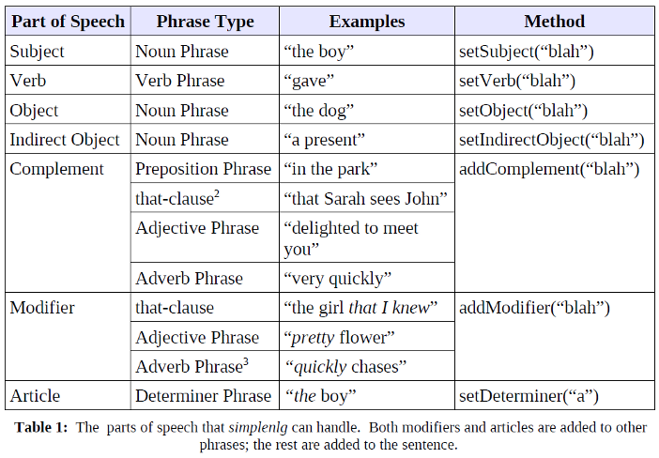
Natural Language Generation
SimpleNLG – a Java API
Notes:
Table to show the kinds of phrases it supports.
Quite flexible.
23

Slide 24
Two problems
1. The sentence problem – 90% solved
2. The context problem
Notes:
That’s the sentence problem. It’s 90% solved – it’s not perfect and still needs quite a lot of contextual information, but there are systems which can create correct and meaningful sentences reliably.
24

Slide 25
Two problems
1. The sentence problem – 90% solved
2. The context problem
Notes:
Let’s look at the context problem.
If we can create sentences, how can we put them together to make a story?
In Teens, correct sentences were strung together but they lacked meaning. Actions had no consequences and character relationships were random and fluctuating. It was a stream of events rather than a story.
25

Slide 26
Define: story
- Actions have consequences
- Something changes over time
- Sense of progression
Notes:
What makes a story a story and not just a bunch of stuff that happens?
Character’s actions need to have consequences – events need to lead into each other in a meaningful way
Something needs to change, usually the characters or the setting
Ultimately need a sense of progression
26

Slide 27
Cpressey’s story generator
Uses predefined characters, objects and settings
Represents story as a tree
Notes:
Created by github user cpressey. Very basic attempt at creating story structure. Won’t show it because it’s quite long, but I’ll describe how it works. Some elements are predefined, but a storyline is generated by creating a tree structure.

Slide 28
Cpressey’s story generator
Introduction
Ending
{ … }
Notes:
Start with introduction – establish the setting, describe the characters.
Ending is typical – I’m so glad we ___ , everybody laughed, things returned to normal, etc.

Slide 29
Cpressey’s story generator
Introduction
Item stolen
Item retrieved
Ending
{ { … } … }
Notes:
Fill in some subplot, e.g. something stolen, somebody got kidnapped, etc. and its resolution.
Can fill in a many of these as you like in the … gaps.

Slide 30
Cpressey’s story generator
{{}{}}, {{}{{}}}
Describe location
Describe char1
Describe char2
Enemy appears
Enemy steals item
Confront Enemy
Retrieve item
Char1 reaction
Char2 reaction
{ { } }
Notes:
Can produce a variety of structures. Once overall structure is in place, each point is expanded into details which will become paragraphs.
Original story generator creates one of these simple stories for each chapter, and the ending caused a permanent change of state for the character (e.g. they got promoted, appearance changed, etc.)
Creates sense of progression.

Slide 31
Viability of this approach
Can stories always be represented using a series of predefined steps?
If so, where’s the creativity?
Notes:
Story generator breaks stories down into a very general structure, but are all stories written this way?
Some people think computer generated fiction is inherently flawed because computers lack creativity, they cannot generate new ideas. They can only construct different variations of whatever we give it. They’ll never come up with something new.
31

Slide 32
The Modularity of Fiction
“There is no such thing as a new idea. It is impossible.
We simply take a lot of old ideas and put them into a sort of mental kaleidoscope. We give them a turn and they make new and curious combinations. We keep on turning and making new combinations indefinitely; but they are the same old pieces of colored glass that have been in use through all the ages.” – Mark Twain
Notes:
Here’s a quote from Mark Twain, an American author most famous for Adventures of Huckleberry Finn
Computers can’t generate new ideas out of thin air, but neither can we. All ideas come from somewhere, and are in fact based on something else, even if it isn’t easy to work out exactly where they came from.
Modularity of fiction - going to look at how it’s possible to break down fiction into easily computable chunks.
32

Slide 33
The Modularity of Fiction
All fiction can be broken down into recurring elements.
Notes:
All fiction is constructed from previous ‘modules’, stuff that’s been seen before, assembled in new ways.
The most obvious example of this is character types – the smart one, the funny one, etc.
The website tvtropes works based on this idea – it records and defines these building blocks. Essentially a big database of them and the works they appear in.
33

Slide 34
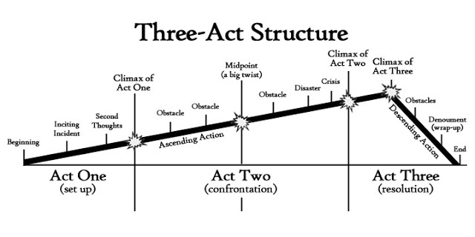
Notes:
To further prove that all fiction shares elements, look at three act structure.
Act one – inciting incident
Act three – climax
34

Slide 35
Notes:
Crisis – easiest to spot. Right before the climax starts, something goes very, very wrong.
This structure is ubiquitous. Almost everything that comes out of Hollywood follows this – once you know how to spot it, you see it everywhere.
Useful high-level model of storytelling.
35

Slide 36
The Modularity of Fiction
Seven basic plots
Notes:
In 2004, English journalist Christopher Booker defined the seven-basic plots. Most plotlines follow one of these (or a combination of them). Won’t describe them all, but here are some examples;
36

Slide 37
The Modularity of Fiction
Seven basic plots
Overcoming the monster
Notes:
Hero learns of some great evil and sets out to destroy it.
37

Slide 38
The Modularity of Fiction
Seven basic plots
Overcoming the monster
Rags to riches
Notes:
Hero starts as nobody and acquires riches / a kingdom / whatever. King Arthur is a good example.
38

Slide 39
The Modularity of Fiction
Seven basic plots
Overcoming the monster
Rags to riches
The quest
Notes:
Hero sets out on a journey to acquire some object, often with companions. Popular in Fantasy.
We can choose one of these plots and get a pretty good idea of the events that have to happen in order to meet it.
39

Slide 40
My Model of Fiction
A story needs a sense of progression.
They are all constructed by remixing known elements.
Some elements of structure can be treated as fixed.
Notes:
So how would I define storytelling to a computer system?
These are the key elements I’ve talked about before. Let’s look at converting them to something a computer could understand.
40

Slide 41
My Model of Fiction
Expand story generator to more sophisticated structure.
Introduction
Ending
Notes:
Look at structure first. We’ll expand with similar ideas to the story generator; define a high-level overview first and then refine it.
Still need introduction and ending.
41

Slide 42
My Model of Fiction
Expand story generator to more sophisticated structure.
Introduction
Inciting Incident
Crisis
Ending
Notes:
Can add our inciting incident and crisis in here to properly fit the three-act structure.
42

Slide 43
My Model of Fiction
Character scale:
Sympathy
Proactivity
Competence
Can also add traits based on predefined building blocks – e.g. tech savvy.
Notes:
All characters can be represented on a scale of different traits – I’d use sympathy, proactivity and competence. Sympathy is how much the audience relates to them. An easy way to quantify this is how much the character conforms to political correctness, e.g. obeying the law.
Proactivity is how much control the character has and the chance they have of putting forward new ideas.
Competence is how likely they are to succeed.
These all directly affect the mechanics of the plot. Can also add other characteristics that affect how the character achieves things.
43

Slide 44
My Model of Fiction
Characters need to change.
Notes:
Pick one of the three key traits that will modify over the course of the story.
44

Slide 45
My Model of Fiction
Characters need to change.
Need to define what might cause this change.
Notes:
People don’t change for no reason.
They change if they are rewarded or punished for their trait (or lack of it.)
A hero gets stronger because he was beaten by the bad guy.
If someone is punished for inaction, they may become more proactive.
If a villain is shown the error of their ways, they might become more sympathetic.
45

Slide 46
My Model of Fiction
Introduction
Introduce setting
Introduce characters
Show trait X
has changed
Crisis
Punish trait X
Inciting Incident
Punish trait X
Ending
Show changes
Notes:
Can add our inciting incident and crisis in here to properly fit the three-act structure.
46

Slide 47
My Model of Fiction
Not just the character that changes.
Also need plot.
Notes:
We can define this even further by overlaying one of the seven basic plots. I’ll choose the quest as it’s easiest to represent.
47

Slide 48
My Model of Fiction
Introduction
Introduce setting
Introduce characters
Show trait X
has changed
Crisis
Punish trait X
Inciting Incident
Punish trait X
Ending
Show changes
Learn of object Y
Journey towards Y
Acquire Y
Return
Notes:
Now have a pretty complex and well-defined structure we can use to build a story. As long as we hit these beats effectively, it WILL be a story.
If we define how to break down these steps further like the story generator, we can effectively describe how to create a story to a computer.
It would build character actions and reactions based on their scale and traits, and progress a fixed plot line.
Can be easily expanded to use multiple plot lines and character arcs.
48

Slide 49
Shortcomings:
Lacks real problem solving
Notes:
Until a computer can fully understand what it means to live as a human, it won’t be able to fully realise all solutions to all problems.
For example, problem solving in fiction changed dramatically when it’s expected that everyone has access to a smartphone. But a computer wouldn’t know what a person could reasonably be expected to have access to without our instruction.

Slide 50
Shortcomings:
Lacks real problem solving
Requires human input
Notes:
This approach requires a lot of human input. Need to predefine very general forms of problems that occur for all seven basic plots and how to solve them, that will work for any combination of character traits. Also need to program in how character traits affect speech and body language.

Slide 51
Shortcomings:
Lacks real problem solving
Requires human input
Gap between high and low level
Notes:
Have NLG to make sentences, and have higher level structure.
Still need to bridge the gap.
How to define the structure of a single chapter?

